Slide 1
CSE 2102: Introduction to Software Engineering
Software Specification
Finite State Machines

Slide 2
Finite State Machines (FSMs)
FSMs describe control aspects of a system
Consist of:
  Finite set of states – Q
  Finite set of inputs – I
  Transition function – d: Q X I -> Q
Good for modeling systems with finite number of states and events which cause state change

Slide 3
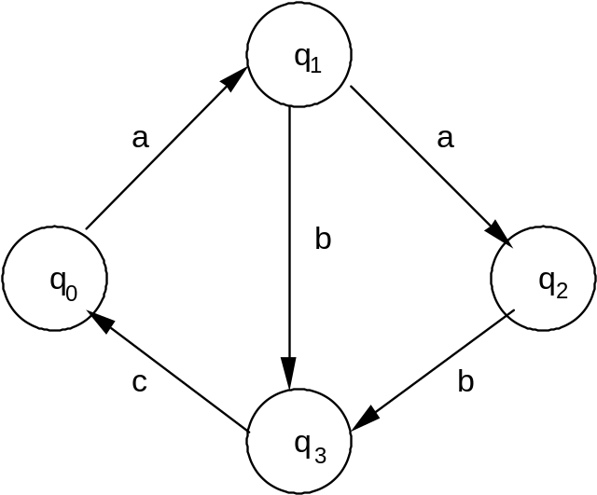
Graphical Notation for a FSM
Graphically,
- States are nodes
- Arcs show transitions

Slide 4
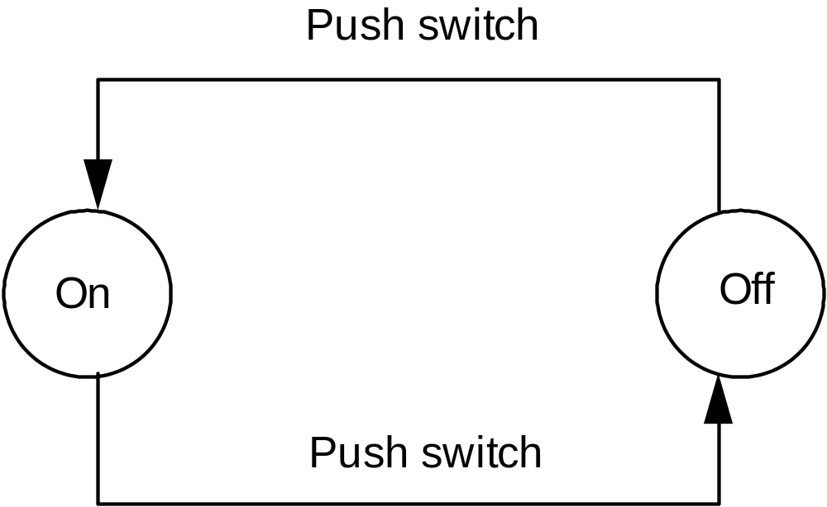
FSM Example: A lamp

Slide 5
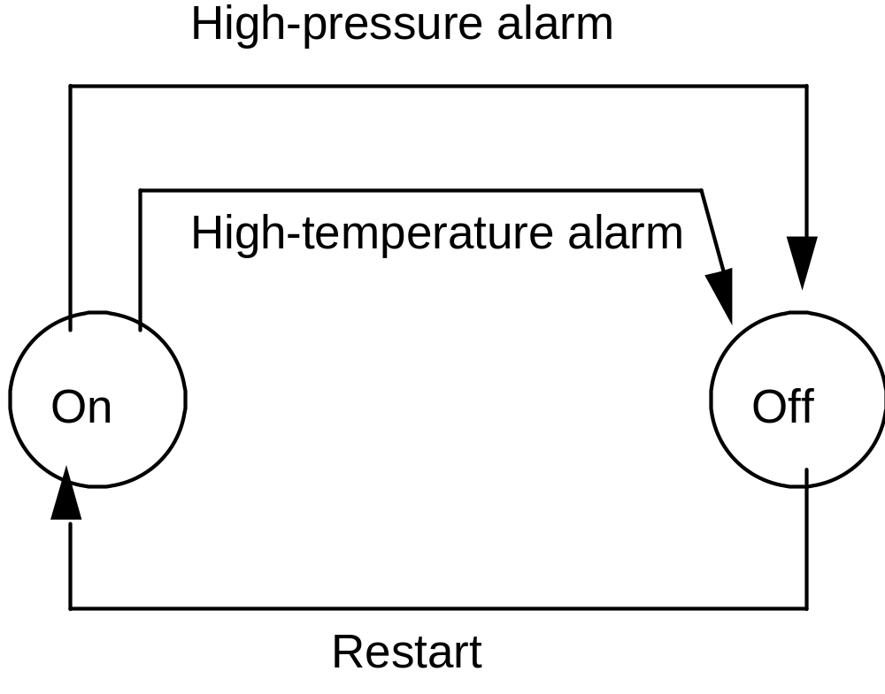
FSM Example: A Plant Control System

Slide 6
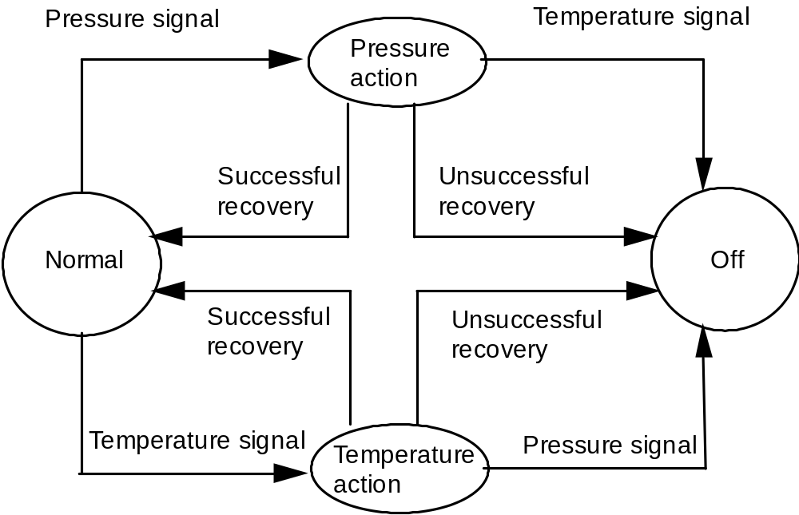
FSM Example: A Refinement of Plant control System

Slide 7
Classes of FSMs
Can be both deterministic and non deterministic
FSMs as recognizers
  Introduce final states
FSMs as transducers
  Introduce set of outputs

Slide 8
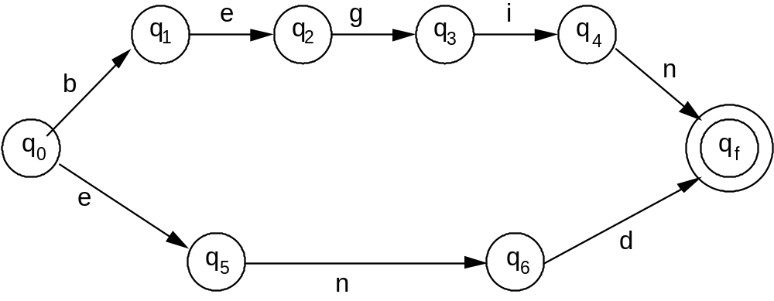
FSMs as Recognizers
FSMs often used to specify acceptable strings
Initial state q₀, member of Q
Final or accepting state(s) q_{f} member of Q
String is accepted if you can start at start state and transition on
input to final state.

Slide 9
FSMs as Recognizers (contd..)
r
e
a
q1
q2
q3
q4
b
d
q0
h
qf
i
r
t
w
q5
q6
q7
q8
e
o
What are the strings accepted by this FSM?
(bread, head, write, wrote)

Slide 10
State Explosion
State explosion is a limitation of FSM.
Given a number of FSMs with k₁, k₂, … k_{n} states, their composition is a FSM with k₁ * k₂ *… * k_{n} states.
This growth is exponential with the number of FSMs, not linear (we would like it to be k₁ + k₂ +… + k_{n} )

Slide 11
State Explosion: An Example
produce
State explosion: An
example
Producer
p
1
p
2
deposit
get
Consumer
c
1
c
2
consume
deposit
deposit
Storage
0
1
2
get
get

Slide 12
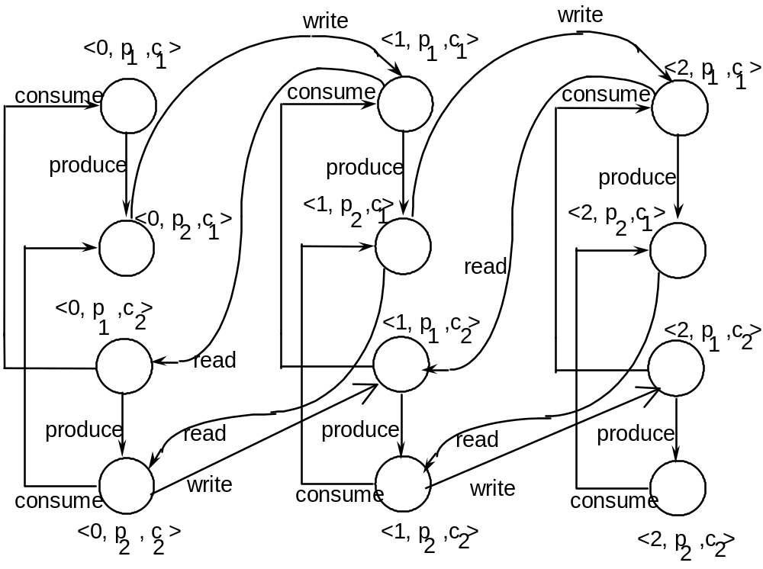
State-Space Explosion: An Example (contd..)
The resulting FSM

Slide 13
State-Space Explosion: An Example (contd..)
In the composite FSM, a state is given by a 3-tuple:
  <state-of-the-storage, state-of-the-producer, state-of-the-consumer>
Storage can be in three states: 0, 1, 2.
Producer can be in two states: p1, p2.
Consumer can be in two states: c1, c2.
Total number of states in the composite FSM: 3x2x2 = 12

Slide 14
State-Space Explosion: An Example (contd..)
Initial state of the composite FSM: <0, p1, c1>
  0 messages in the storage,
  Producer in state p1 -- can produce a message,
  Consumer in state c1 -- consumer can get a message if the message is available.
Only one event can occur in the initial state:
  Producer produces a message
  Transitions the FSM to state <0, p2, c1>.
In state <0, p2, c1>, also one message can occur:
  Producer writes or deposits the message to the buffer.
  Transitions the FSM to state <1, p1, c1>.

Slide 15
State-Space Explosion: An Example (contd..)
Multiple events can occur in state <1, p1, c1>:
  Producer produces another message, FSM transitions to state <1, p2, c1>.
  Consumer reads the message that is in the storage, FSM transitions to state <0, p1, c2>.
Consumer consumes the message, the FSM transitions back to the initial state which is <0, p1, c1>.
A composition of even simple 2-3 state FSMs can become very complicated.

Slide 16
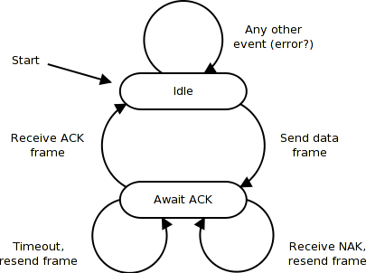
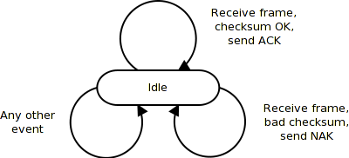
FSM Example: ARQ protocol
Simple stop and wait protocol :Automatic Repeat reQuest (ARQ)
– If error is detected by receiver, it discards the frame and send
a negative ACK (NAK), causing sender to re-send the frame
– In case a frame never got to receiver, sender has a timer: each time
a frame is sent, timer is set
→ If no ACK or NAK is received during timeout period, it re-sends
the frame

Slide 17
FSMs Summary
Simple and widely used:
  Control systems, Compilation, Pattern matching, Hardware design
FSMs useful for modeling systems with a single current state.
FSMs may become complex:
  Approximate requirements
  Switch models
  Enrich the model (predicates for transitions)
FSMs can be composed to create new FSMs
  Combine arcs where necessary
  Cardinality may grow (state explosion problem)

